Slide 1
Free Body Diagrams
Dr. Jacob Moore
Associate Professor of Engineering
Penn State Mont Alto

Slide 2
Free Body Diagrams
A free body diagram is a simplified version of a physical system that engineers use as a starting point for analysis.
Physical System
Free Body Diagram
Equations of Equilibrium / Motion

Slide 3






What is a Free Body Diagram
Problem Diagram
Free Body Diagram
$$F_{N1}$$
$$F_{m}$$
1 m
1 m
$$F_{g}$$
2 m
65º
$$F_{F}$$
$$F_{N2}$$

Slide 4
Creating a Free Body Diagram
Draw a picture of the body being analyzed separate from all the background objects.
Draw in any forces acting on the body.
Normal forces at any point of contact
Gravitational forces
Friction forces on rough surfaces
Tension in any cables or wire.
etc.
Add any angles for the force vectors and any key dimensions

Slide 5


Common Forces (Gravitational Forces)
Gravitational Forces are the forces present due to the weight of an object.
We will usually model them as point forces acting downward (towards the center of the earth) at the center of mass of the body.
In the US customary system we are usually directly given the weight force, in the metric system we will need to multiply the mass by g (9.81 N/kg at sea level) to find the weight force in Newtons.
60 lb box
COM
$$F_{g}=60 lbs$$
60 kg box
COM
$$F_{g}=60 ∗9.81=588.6 N$$

Slide 6
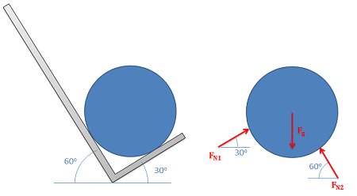
Common Forces (Normal Forces)
Normal forces (also sometimes called reaction forces) are the forces that prevent two bodies from occupying the same place at the same time.
They will always act perpendicular to the surfaces in contact at the point of contact.

Slide 7
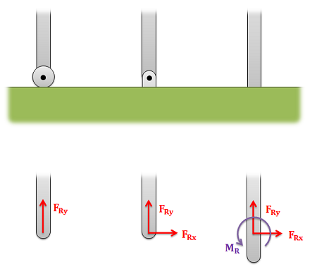
Common Forces (Normal Forces)
Another common type of normal force exists between connected bodies.
These connections can exert normal forces and even moments to prevent motion in certain directions.

Slide 8
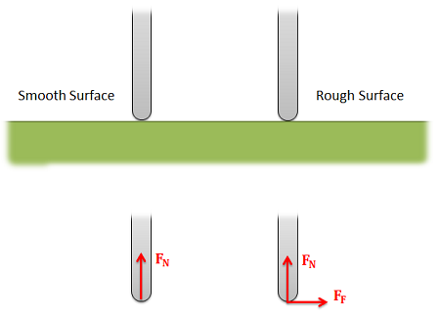
Common Forces (Friction)
Friction forces will act between any two surfaces sliding relative to one another and will always act parallel with the surfaces in contact opposing motion or potential motion.
It can be a complex interaction, but for simple scenarios we often assume smooth surfaces (no friction) or rough surfaces (what ever force is necessary to prevent sliding).

Slide 9
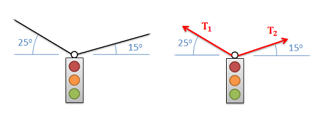
Common Forces (Tension)
Cables, ropes, or other flexible connections will often carry tension forces.
These forces will always be pulling in the direction of the cable itself.

Slide 10
Creating a Free Body Diagrams (Review)
Draw a picture of the body being analyzed separate from all the background objects.
Draw in any forces acting on the body.
Direct pushing or pulling forces
Normal forces at any point of contact
Gravitational forces
Friction forces on rough surfaces
Tension in any cables or wire.
etc.
Add any angles for the force vectors and any key dimensions

Slide 11

Creating a Free Body Diagram
Problem Diagram
Free Body Diagram
$$F_{N1}$$
$$F_{m}$$
1 m
1 m
$$F_{g}$$
2 m
65º
$$F_{F}$$
$$F_{N2}$$

Slide 12
Thanks for Watching
See other engineering mechanics videos and access the full tool at…

Slide 13
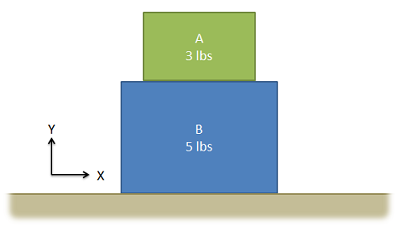
Free Body Diagram Worked Example
Draw a free body diagram of each of the two boxes below.

Slide 14
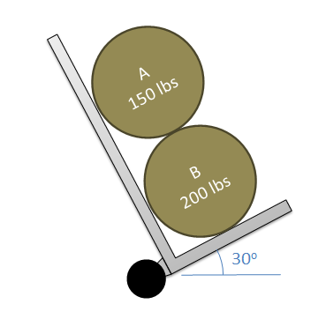
Free Body Diagram Worked Example
Two equally sized barrels are being transported in a hand truck as shown below. Draw a free body diagram for each of the barrels below.

Slide 15
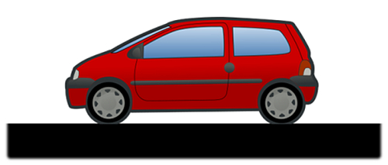
Free Body Diagram Worked Example
The car shown below is moving and then slams on the brakes, locking up both front and back wheels. The distance between the wheels is 8 feet and the center of mass is 3 feet behind and 2.5 feet above the point of contact between the front wheel and the ground. Draw the free body diagram of the car as it comes to a stop.

Slide 16
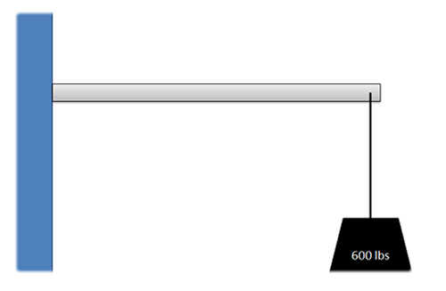
Free Body Diagram Worked Example
A 600 lb load is supported by a 5 foot long 100 lb cantilever beam (assume center of mass halfway along beam) that is firmly attached to the wall. Draw a free body diagram of the beam.

Slide 17
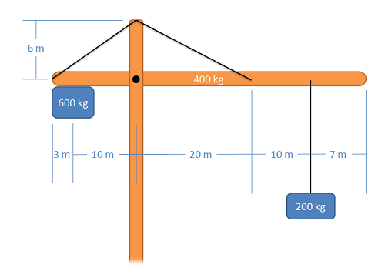
Free Body Diagram Worked Example
The main arm of a crane has a mass of 400kg (assume the center of mass is at the midpoint of the arm) and supports a 200 kg load and a 600 kg counterweight. The arm is connected to the vertical support via a pin joint and two flexible cables. Draw a free body diagram of the arm.

